Slide 1

Defining Methods
A method is a collection of statements that are grouped together to perform an operation.

Slide 2
Method Signature
Method signature is the combination of the method name and the parameter list.

Slide 3
Formal Parameters
The variables defined in the method header are known as formal parameters.

Slide 4
Actual Parameters
When a method is invoked, you pass a value to the parameter. This value is referred to as actual parameter or argument.

Slide 5
Return Value Type
A method may return a value. The returnValueType is the data type of the value the method returns. If the method does not return a value, the returnValueType is the keyword void. For example, the returnValueType in the main method is void.

Slide 6
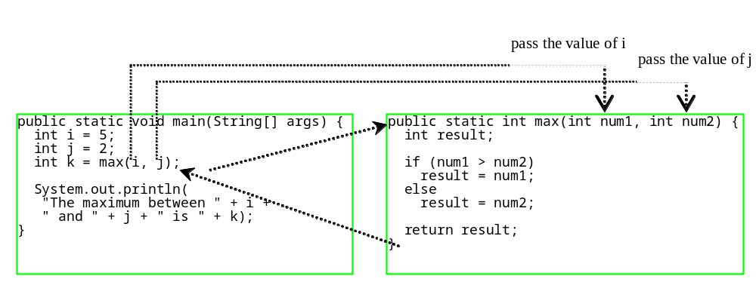
Calling Methods, cont.
animation

Slide 7

CAUTION
A return statement is required for a value-returning method. The method shown below in (a) is logically correct, but it has a compilation error because the Java compiler thinks it possible that this method does not return any value.
To fix this problem, delete if (n < 0) in (a), so that the compiler will see a return statement to be reached regardless of how the if statement is evaluated.

Slide 8
Reuse Methods from Other Classes
NOTE: One of the benefits of methods is for reuse. The max method can be invoked from any class besides TestMax. If you create a new class Test, you can invoke the max method using ClassName.methodName (e.g., TestMax.max).

Slide 9
Passing Parameters
public static void nPrintln(String message, int n) {
for (int i = 0; i < n; i++)
System.out.println(message);
}
Suppose you invoke the method using
  nPrintln(“Welcome to Java”, 5);
What is the output?
Suppose you invoke the method using
  nPrintln(“Computer Science”, 15);
What is the output?
Can you invoke the method using
  nPrintln(15, “Computer Science”);

Slide 10

Overloading Methods
Overloading the max Method
public static double max(double num1, double num2) {
if (num1 > num2)
return num1;
else
return num2;
}
TestMethodOverloading

Slide 11
Ambiguous Invocation
Sometimes there may be two or more possible matches for an invocation of a method, but the compiler cannot determine the most specific match. This is referred to as ambiguous invocation. Ambiguous invocation is a compile error.

Slide 12
Ambiguous Invocation
public class AmbiguousOverloading {
public static void main(String[] args) {
System.out.println(max(1, 2));
}
public static double max(int num1, double num2) {
if (num1 > num2)
return num1;
else
return num2;
}
public static double max(double num1, int num2) {
if (num1 > num2)
return num1;
else
return num2;
}
}

Slide 13
Scope of Local Variables
A local variable: a variable defined inside a method.
Scope: the part of the program where the variable can be referenced.
The scope of a local variable starts from its declaration and continues to the end of the block that contains the variable. A local variable must be declared before it can be used.

Slide 14
Scope of Local Variables, cont.
You can declare a local variable with the same name multiple times in different non-nesting blocks in a method, but you cannot declare a local variable twice in nested blocks.

Slide 15

Scope of Local Variables, cont.
A variable declared in the initial action part of a for loop header has its scope in the entire loop. But a variable declared inside a for loop body has its scope limited in the loop body from its declaration and to the end of the block that contains the variable.

Slide 16

Scope of Local Variables, cont.

Slide 17
Scope of Local Variables, cont.
// Fine with no errors
public static void correctMethod() {
int x = 1;
int y = 1;
// i is declared
for (int i = 1; i < 10; i++) {
x += i;
}
// i is declared again
for (int i = 1; i < 10; i++) {
y += i;
}
}

Slide 18
Scope of Local Variables, cont.
// With errors
public static void incorrectMethod() {
int x = 1;
int y = 1;
for (int i = 1; i < 10; i++) {
int x = 0;
x += i;
}
}

